Slide 1
BAGUIO APLA 2017
FEBRUARY 23-25, 2017

Slide 2
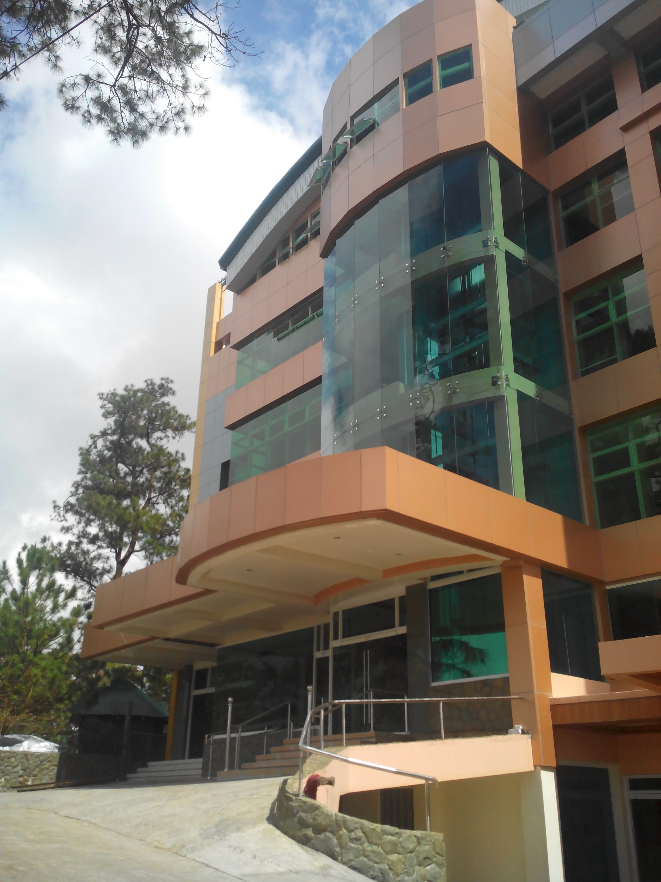
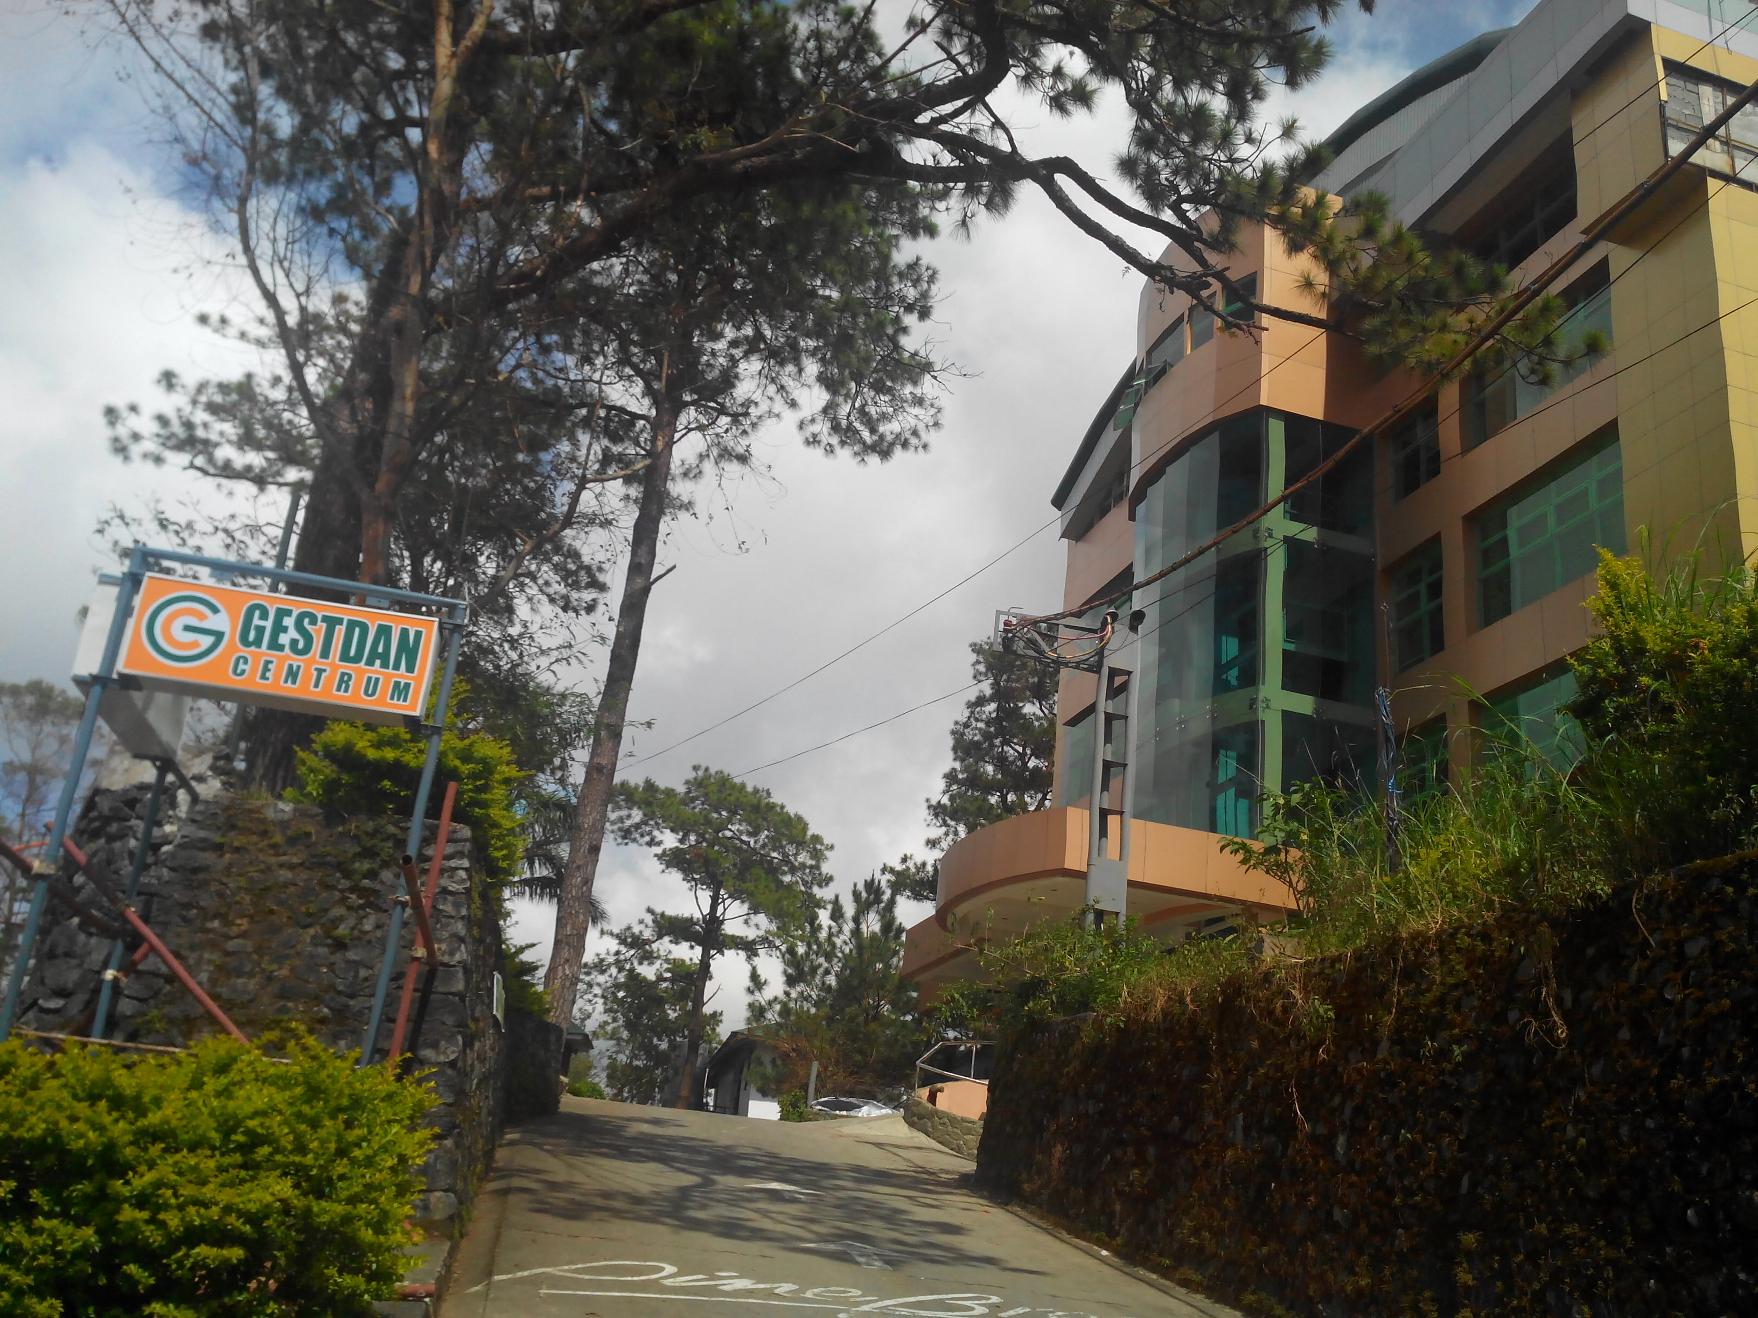
Venue: Gestdan Centrum Building (4th floor)
No. 80 Bokawkan Road (just outside Pine Breeze Cottages)

Slide 3
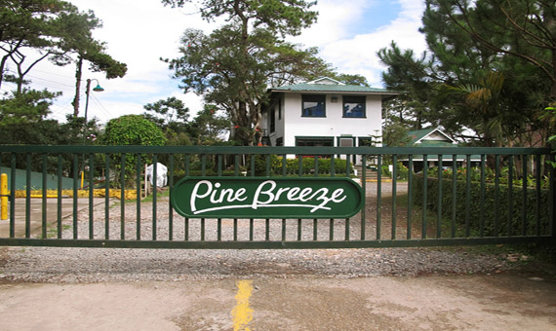
Housing Details
Since the APLA dates fall on the Panagbenga weekend, all delegates will be housed in Pine Breeze Cottages which is just beside the venue and is a short jeepney ride away from downtown.
There are 25 cottages for rent, with occupancy ranging from 4 to 16 per cottage. We need 100-150 tenants per night for us to get the package rates. We booked the nights of February 22-26 (Wednesday to Sunday nights, minimum of 50 pax needed only for Sunday night). Reservations are on a first come, first served basis.
The rates are the following:
* P360 per head per night for adults and children 11 years old and up
* P175 per head per night for children 1-10 years old
Visit www.pinebreezebaguio.com for photos and more details.

Slide 4
Room Set Up
Cottages | # of Pax Per Cottage | Extra Bed Per Cottage | Maximum # of Pax Per Cottage
A4,D1, D2,F2, F3,E4, E5, E6, E7,E8,E9, E10 – 12 cottages | 4 | 2 (D1,F2, F3 – 1 extra bed) | 6 (D1,F2, F3 – 5 pax per room )
A1, A2, A3,B1, B2 – 5 cottages | 5 | 2 (B1 – 1 extra bed) | 7 (B1 – 6 pax)
D – 1 cottage | 6 | 2 | 8
H1, F4 – 2 cottages | 7 | 2 | 9
H2,F – 2 cottages | 8 | 2 | 10
B, F1– 2 cottages | 11 | B – plus 5 beds, F1 – plus 3 beds | B – 16, F1 – 14
B3 – 1 cottage | 12 | 3 | 15
Total = 25 cottages | 143 | 51 extra beds | 194

Slide 5
Reminders
There are no rooms for 2 people only since the smallest rooms in Pine Breeze are for 4-6 pax. Married couples can either share rooms with other couples or may be separated and join other brothers or sisters.
We encourage all delegates to book in Pine Breeze for convenience and low rates, and to avoid high hotel rates, fully booked hotels, and the big crowds and heavy traffic in the city during that weekend. Disciples' family members who are non-disciples (i.e. parents, spouses, siblings, children) can also get the package rate if they stay in Pine Breeze.
Delegates who will not stay in Pine Breeze and choose to stay in other hotels will make their own reservations and pay the regular rates. You can check online for other hotel options and their rates and contact details.
Please take note of the following payment scheme & deadlines (we also accept full payments before February 15):
January 10, 2017 – 30% of the total payment (mandatory down payment to secure your room)
January 30, 2017 – 30 % of the total payment
February 15, 2017 – 40 % of the total payment (deadline of full payment and reservations)
Please give your individual payments to your church leaders/point persons. Payment is nonrefundable but the reservation can be transferred to another guest if needed.

Slide 6
Reminders
Baguio will arrange the room reservations in Pine Breeze. To delegates, please inform your respective church/sector leaders, who will submit your details to Jhun Hugo from Baguio. Monica Estioco will also get initial reservations at the APLA in Dumaguete this November. We need to have initial reservations by November 27, 2016 that we can submit to Pine Breeze by December.
There is no child care provided during the APLA. The use of the Pine Breeze function hall is included free of charge, so the children and their carers can stay in the hall while the parents are taking their classes.
The worship service on February 26 will be held at the Pine Breeze function hall in the afternoon to give everyone a chance to watch the Panagbenga Float Parade in the morning (and to avoid the heavy traffic for Baguio residents).
There are exciting activities lined up for delegates especially in the evenings, so watch out for more announcements in the coming months. For inquiries, please feel free to contact the following:
Monica Estioco (point person; housing and hotel recommendations) - 09321341768; monique7783@gmail.com
Jhun Hugo (for other APLA concerns) - 09309435499; jhun_hugo@yahoo.com
Eric Sismaet (church leader) - 09328819660, 09215140621; esismae@yahoo.com

Slide 7
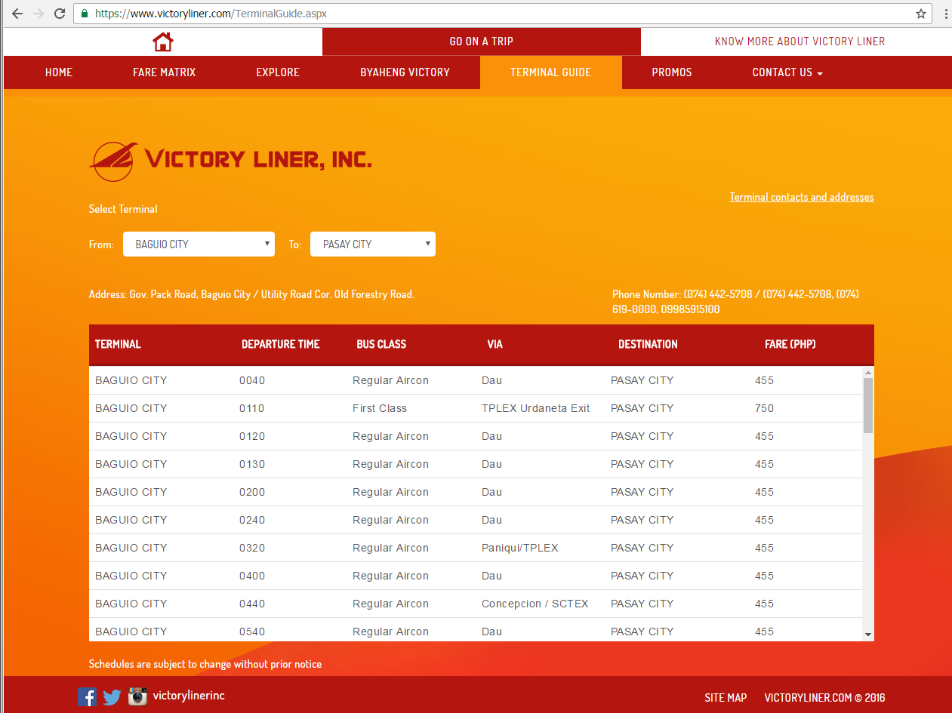
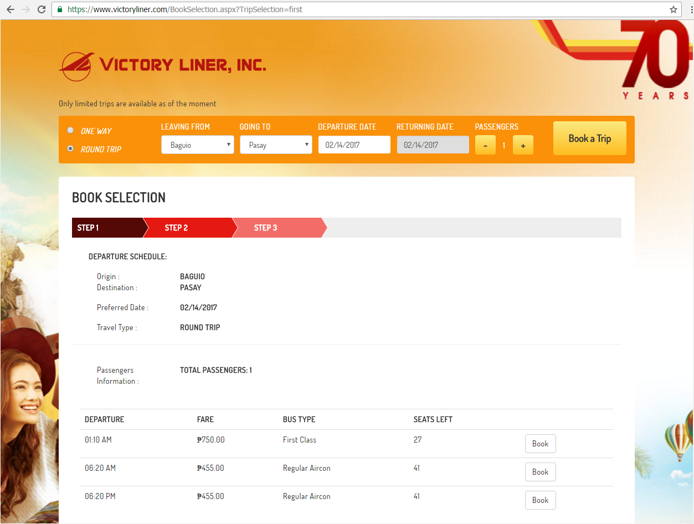
Reminders
To those who are commuting, please book your bus tickets for departure from Baguio IN ADVANCE on www.victoryliner.com to avoid sold out buses after the Panagbenga (sometimes buses get sold out up to 3 days after the festival). The website offers detailed instructions on how to reserve your tickets. Please allot 7-8 hours travel time from Baguio to Manila (plus two hours if you have a flight).

Slide 8
THANK YOU!

