Slide 1
APLA in Bohol 2018
Marriage and Family 1
May 4-6, 2017

Slide 2
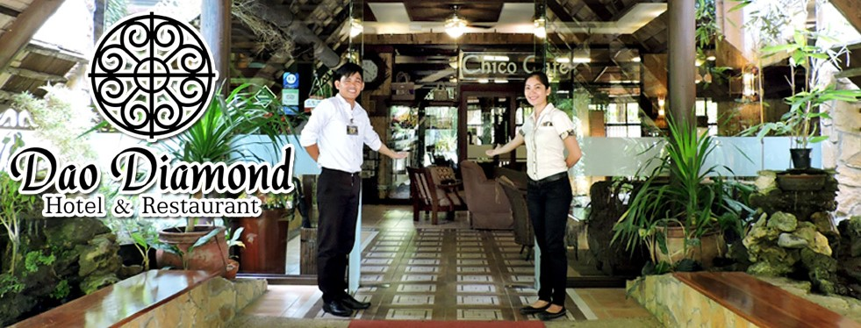
VENUE for APLA in Bohol
For inquiries or assistance, please contact January Samson through messenger (Jan New) or 0920-9713179.
Messenger group chat: APLA Bohol 2018

Slide 3
Dao Daimond Hotel & Restaurant Km. 3, Dao District, Tagb. City 038-5018890 / 0917-3062946
VENUE FOR APLA
Room | # of persons | Rate
13 Standard | 2 | P1,650
4 Superior | 2 | P2,365
2 Family | 5 | P4,600
2 Premier Family | 5 | P5,100
1 Family Suite | 5 | P5,700
5 Dormitory | 10 | P550/pax
1 Dormitory | 14 | P550/pax
ALREADY RESERVED
STILL AVAILABLE
Except for dorm type, all rooms are with free breakfast. Additional person is at P725/pax.

Slide 4
Panda Tea Garden Suites Dao District, Tagbilaran City 038-4122456
VENUE FOR APLA
Room | # of persons | Rate
5 Twin | 2 | P1,375
3 Deluxe | 2 | P1,600
2 Superior Suite | 2 | P1,980
2 Executive | 2 | P2,750
No free breakfast.
Additional person is at P250/pax.
9-minute walk to Dao Diamond
With restaurant, coffee shop & bakeshop named “Library.”

Slide 5
Reyna’s Haven & Gardens New Calceta St., Tagbilaran City 038-4120825
VENUE FOR APLA
Room | # of persons | Rate
6 Double Deluxe | 2 | P1,000
No free breakfast.
P200 each for extra person.
7-minute ride from Dao Diamond.

Slide 6
Constrell Pension House New Calceta St., Tagbilaran City 038-5018419
VENUE FOR APLA
Room | # of persons | Rate
7 Standard | 2 | P800
8 Superior | 2 | P1,200
5 Deluxe | 2 | P1,400
No free breakfast.
P250 each for extra person.
7-minute ride from Dao Diamond.

Slide 7
Arabelle Suites New Calceta St., Tagbilaran City 038-4110607 / 038-5019614
VENUE FOR APLA
Room | # of persons | Rate
9 Standard | 2 | P1,250
6 Superior | 2 | P1,550
2 Deluxe | 2 | P1,750
2 Executive | 2 | P2,800
All rooms with free breakfast.
P300 each for extra person.
7-minute ride from Dao Diamond.

Slide 8
Kew Hotel J.A. Clarin St. , Dao District, Tagb. City 038-5010730
VENUE FOR APLA
Room | # of persons | Rate
34 Standard | 2 | P2,500
16 Deluxe | 2 | P3,300
Deluxe Corner | 3 | P4,000
All rooms are with free breakfast. 13-minute walk or 3-minute ride from Dao Diamond.

Slide 9
Sun Avenue Gallares. St., Tagbilaran City 038-4125601 / 038-5018928
Room | # of persons | Rate
6 Duet | 2 | P1,100
12 Double/twin | 2 | P1,350
2 Premier | 2 | P1,600
2 Family | 3 | P1,950
1 Penthouse | 4 | P2,950
Downtown area, near the port.
All rooms are with free breakfast except for Duet.
P350 for each extra person
12-minute ride from Dao Diamond.

Slide 10
Wregent Plaza Hotel CPG Avenue, Tagbilaran City 038-4113971 / 038-5017086
Room | # of persons | Rate
Standard Double | 2 | P1,350
Deluxe Double | 2 | P1,700
Suite | 2 | P2,200
Executive Suite | 2 | P2,500
Superior Suite | 2 | P2,900
Downtown area, near the port.
All suite rooms are with free breakfast.
P500 for each extra person
10-minute ride from Dao Diamond.

Slide 11
Moonlight Inn Espuelas St., Tagbilaran City 038-5010395 / 09471955891
Room | # of persons | Rate
5 Double | 2 | P600
6 Double | 2 | P1,000
P100 for each extra person.
New inn, clean and accessible.
8-minute ride from Dao Diamond.

Slide 12
Francesca’s Inn – Bed & Breakfast Espuelas St., Tagbilaran City 0922-8442796
Room | # of persons | Rate
3 Budget (common CR) | 2 | P595
3 Standard Double | 2 | P695
3 Deluxe | 2 | P850
Feels like home, clean and accessible.
Beside Moonlight Inn.
8-minute ride from Dao Diamond.

